Slide 1

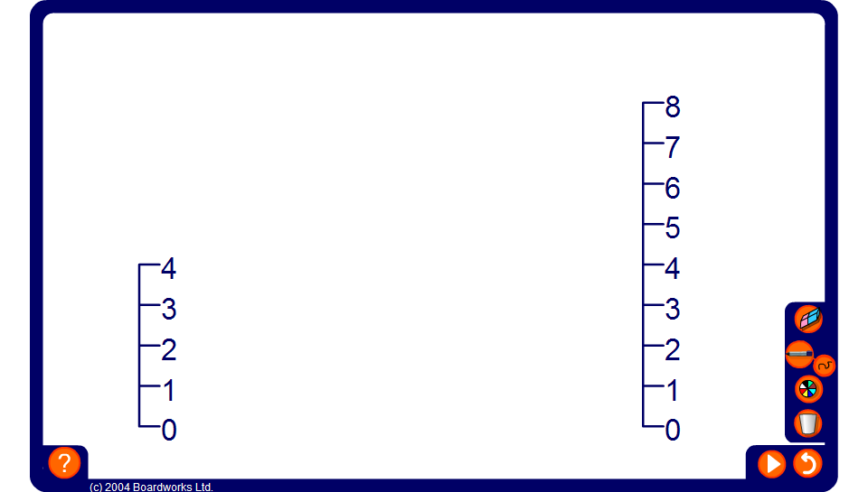


Scale factor diagrams
Notes:
Use this activity to show how we can scale from one whole number to another in a single step.

Slide 2
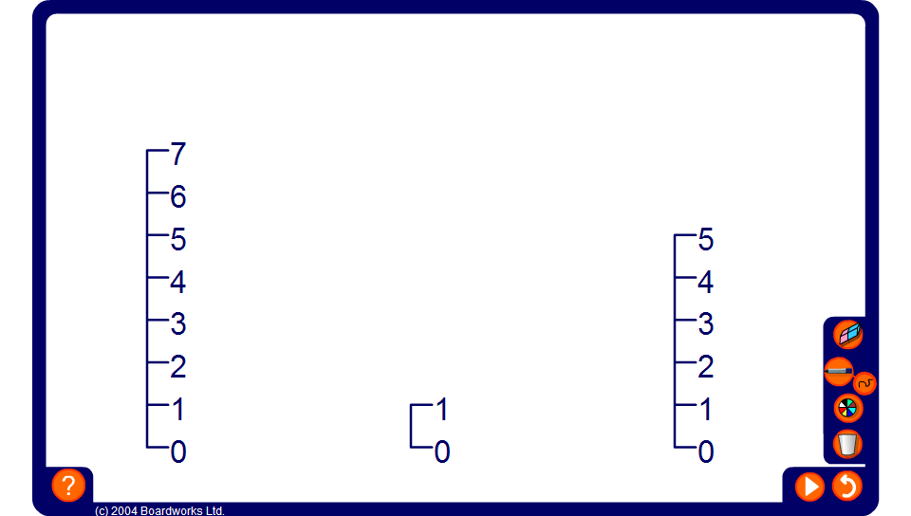
Scale factor diagrams
Notes:
Use this activity to show how we can scale from one whole number to another in two steps, by first scaling down to 1.

